Slide 1

Database Project: Customer Data for Targeting
An analysis of customer data and database design to enhance marketing campaigns for banking products and services.

Slide 2



Executive Summary
Increasing financial access leads to customer awareness
Engaging marketing campaigns are challenging
Precise targeting strategy is crucial
Banks need to adopt a precise targeting strategy to allocate their resources efficiently and maximize gains from marketing campaigns.
As customers gain access to more financial resources and services, they become increasingly aware of marketing tactics employed by banks and financial institutions.
Creating marketing campaigns that are engaging and rewarding for customers to attract new clients has become a significant challenge for banks.
Effective utilization of customer data and analytics is essential for banks to develop targeted marketing campaigns that resonate with potential customers and optimize resource allocation.

Slide 3





Database Design
Established many-to-one relationships between CUSTOMERS and supporting entities.
Identified CUSTOMERS as the central entity with comprehensive customer information.
Normalized tables to eliminate redundancy and enhance query performance.
Designed supporting entities like MARITAL_STATUS to decode categorical data in CUSTOMERS.
Implemented primary and foreign key constraints for data integrity.

Slide 4
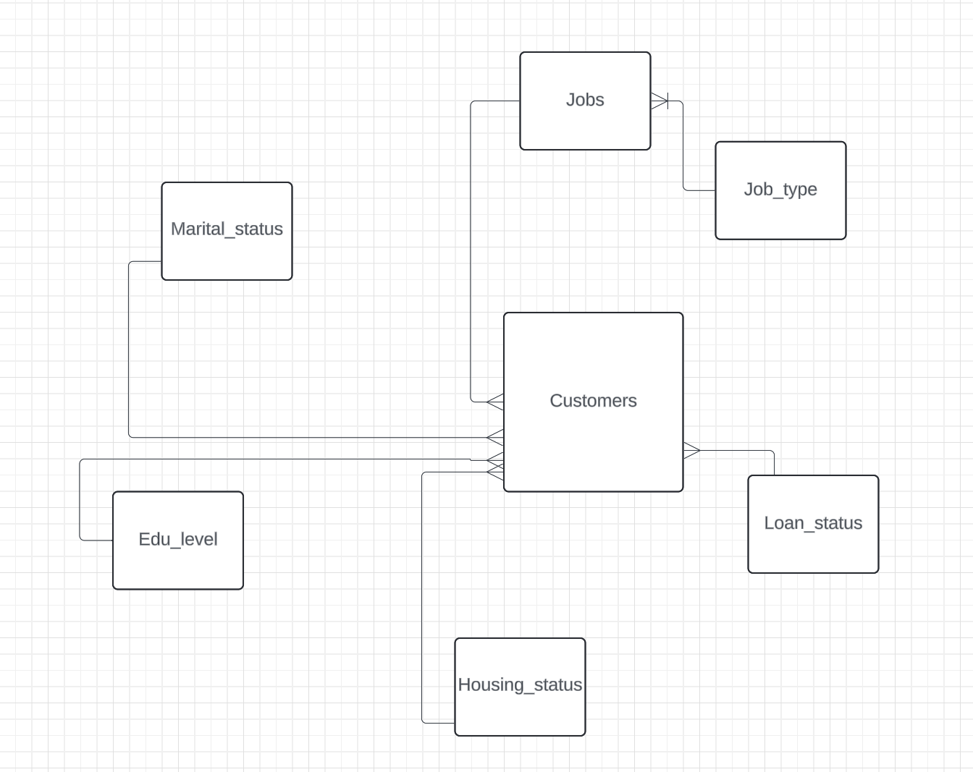
Database Design (Conceptual Design)
Customers
Jobs
Job Type
Loan Status
Housing Status
Education level
Marital Status
Conceptual Design

Slide 5
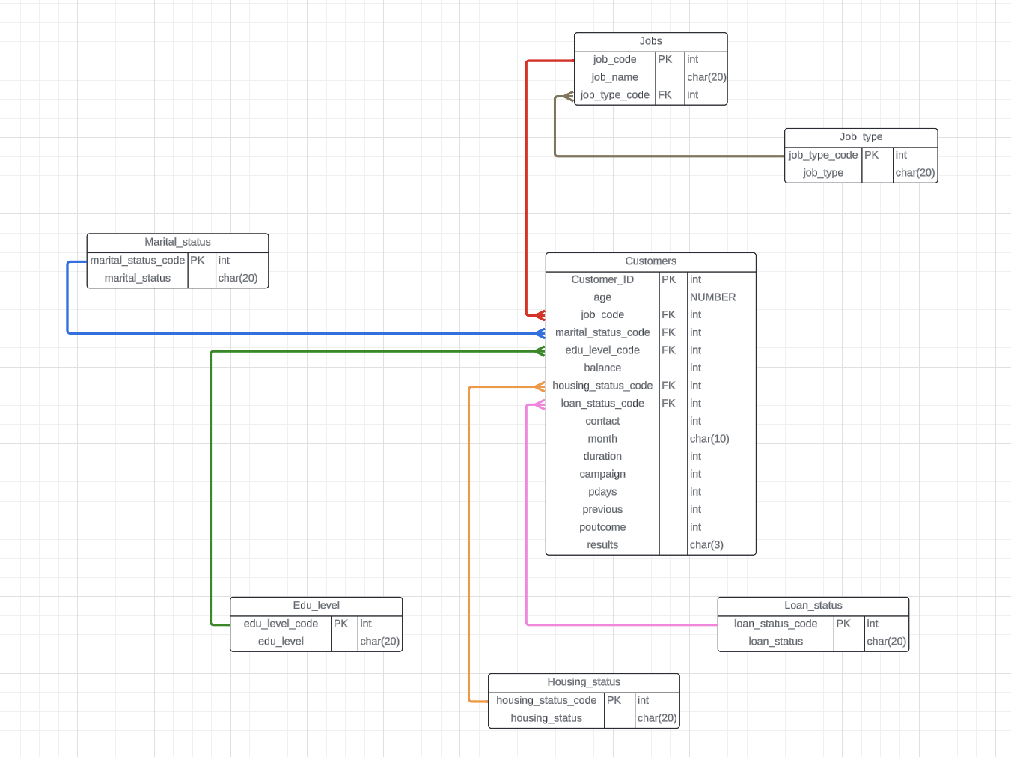
Database Design (Entity-Relationship Diagram)
Entity-Relationship Diagram (ERD)

Slide 6
Query Writing
Point Query
Executed a query to retrieve the customer with the maximum balance, requiring a full table scan and resulting in high consistent gets and cost estimates.
Range Query
Queried to select customers contacted in June and July, involving intensive range scans over a large number of rows, leading to significant I/O activities and suboptimal performance.
Scan Query
Performed a full table scan to aggregate the number of customers contacted per month, exhibiting high consistent gets due to the lack of indexing or other optimizations.

Slide 7



Performance Tuning
Partitioning
Indexing
Parallelism
Partitioned the large CUSTOMERS table by RANGE on the AGE column into 6 partitions
Allowed queries targeting specific age ranges to scan fewer partitions, reducing I/O and improving performance.
Created B-tree indexes on the MONTH and BALANCE columns of the CUSTOMERS table.
Indexing facilitated faster data retrieval by utilizing index structures, significantly reducing consistent gets and execution times for queries involving indexed columns.
Enabled parallel by setting the PARALLEL degree of the CUSTOMERS table to 4.
Allowed complex queries to be divided and processed simultaneously across multiple CPUs, marginally reducing response times.

Slide 8
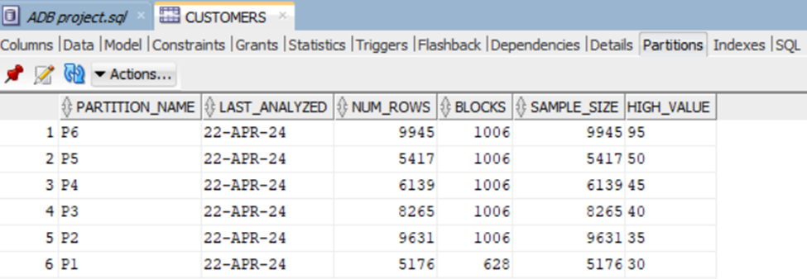
Performance Tuning (Partitioning)
-- Partition the customers table
PARTITION BY RANGE (age)
(
PARTITION p1 VALUES less than (30),
PARTITION p2 VALUES less than (35),
PARTITION p3 VALUES less than (40),
PARTITION p4 VALUES less than (45),
PARTITION p5 VALUES less than (50),
PARTITION p6 VALUES less than (95)
);

Slide 9
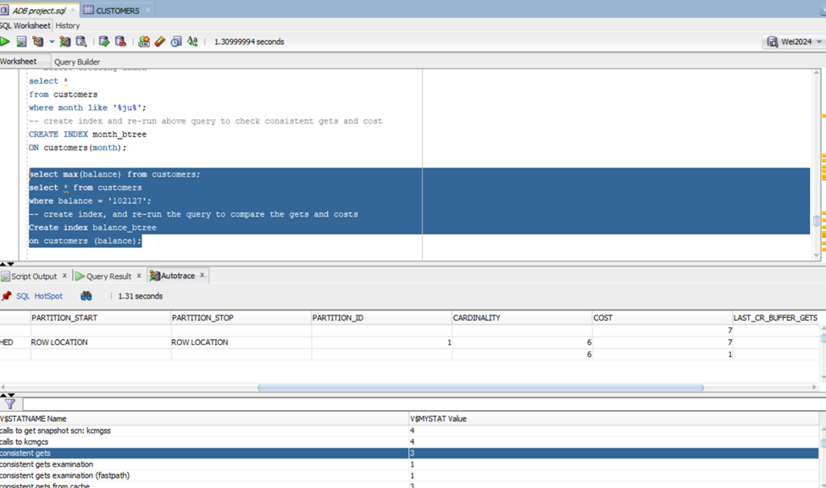
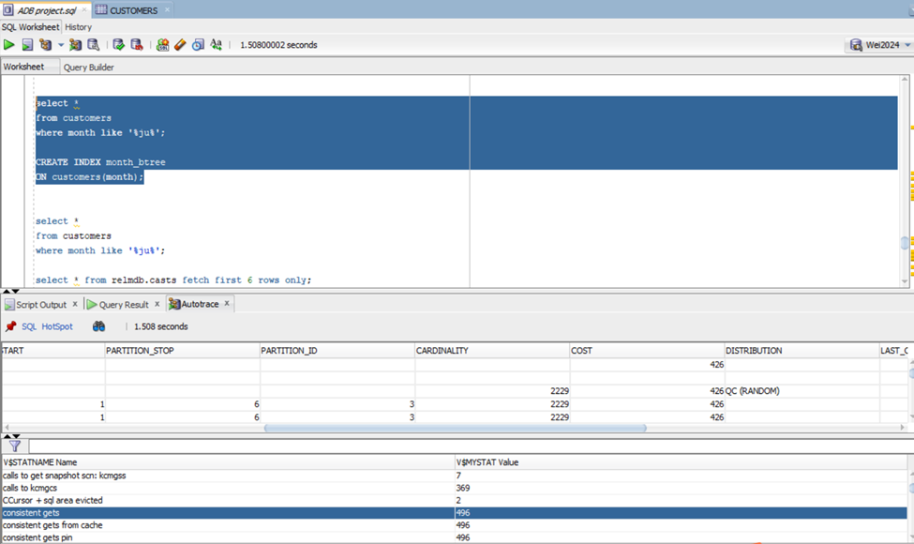
Performance Tuning (Indexing)
-- Create indexes on the customer entity
CREATE INDEX month_btree
ON customers(month);
Point Query with Indexed Column
Range Query with Indexed Column

Slide 10
Performance Tuning (Parallel)
-- exeution without parallel
select customer_id, balance,results,job_type
from customers
join jobs
using (job_code)
join job_type
using (job_type_code)
where (age between 30 and 50)
and balance >= 10000;
-- parallel with degree of 4 on and re-run the query, speed did increase
alter table customers parallel 4;
select customer_id, balance,results,job_type
from customers
join jobs
using (job_code)
join job_type
using (job_type_code)
where (age between 30 and 50)
and balance >= 10000;

Slide 11
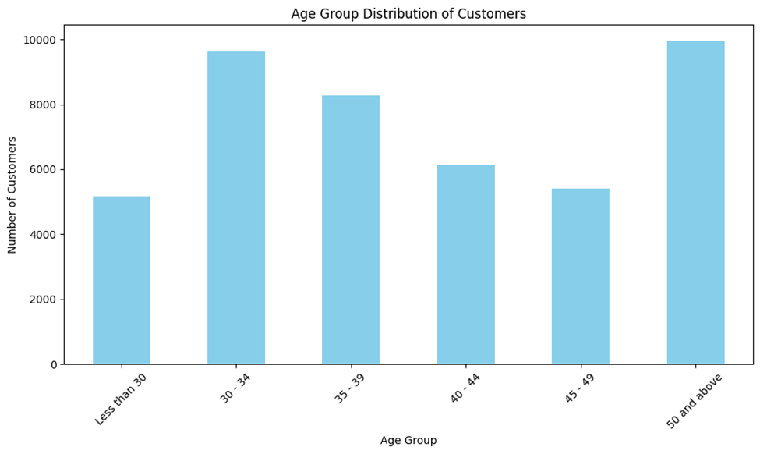
Data Visualization
Imported the data into Python
Constructed visualization utilizing Python matplotlib package
Customer distribution density by age groups
Mian groups: 30 - 49 years old
Among groups between 30-49, customers decrease as age increases.
customers over 50 account for a significant percentage of their customer base.

Slide 12
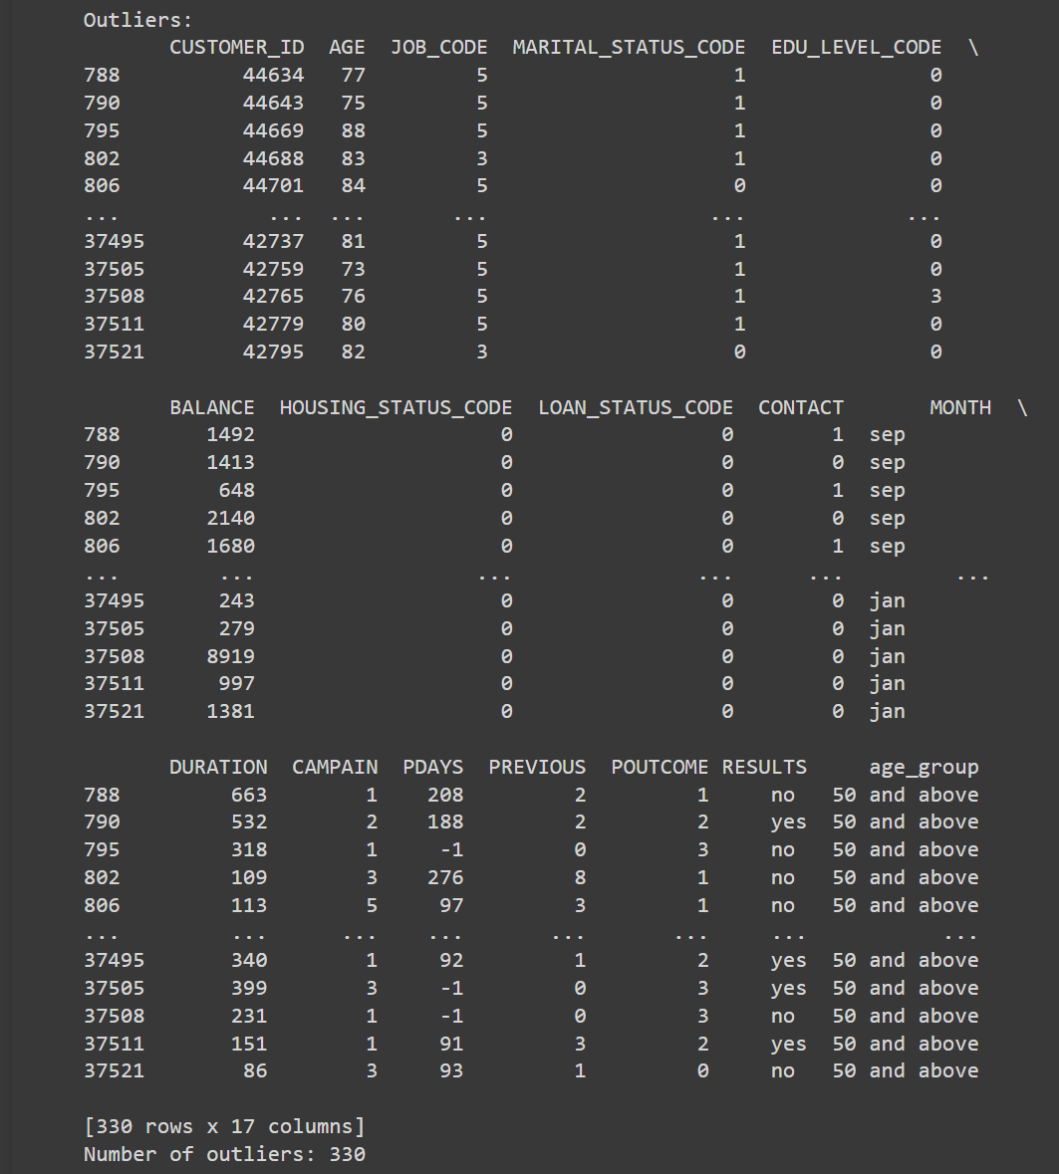
Outlier lookup of Data Mining
Outliers:
any observations that fall outside of three standard deviations from the mean.
Outlier effect:
leads to quality issues
creates unusual patterns
results in misleading insights in analysis.
Calculated mean and standard deviation with Python, and identified outliers
A total number of 330 outliers are detected

Slide 13


